Slide 1
Relationship between Intangible Capital, Knowledge and Maintenance Performance in a PSS Network: An Empirical Investigation
by
Yaoguang Hu, Jiawei Ke, Zhengjie Guo, Jingqian Wen
Presenting Author: YAOGUANG HU
BEIJING INSTITUE OF TECHNOLOGY
BEIJING, CHINA
HYG@BIT.EDU.CN

Slide 2
Outline
Introduction
Hypothesis Development
Methodology
Results and Discussions
Conclusion

Slide 3
Introduction
PSS network
Maintenance performance
Product→PSS

Slide 4
Product PSS
Servitization of manufacturing
maintenance competence
*Adopt from www.ge.com

Slide 5
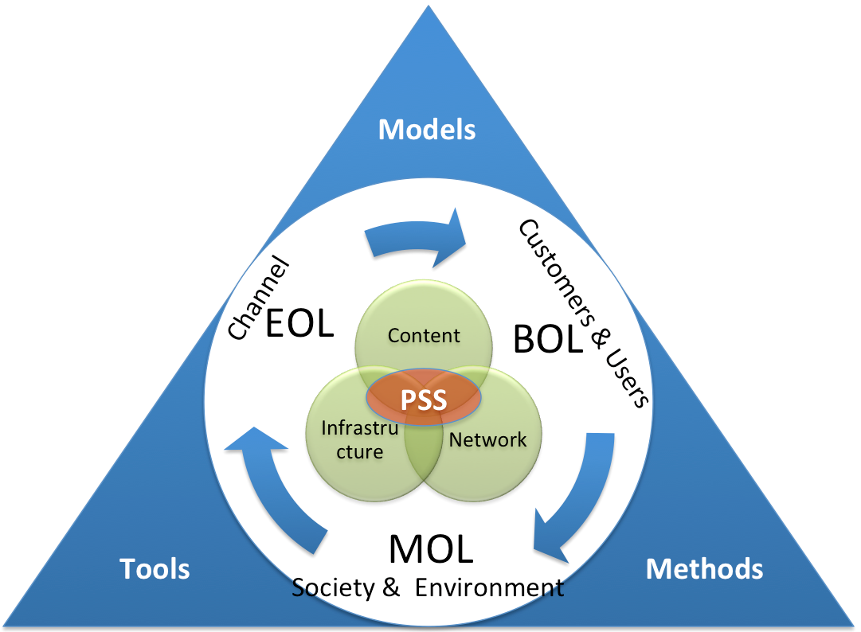
Product PSS
A system view of PSS Engineering
Leveraging the strengths of a dynamic PSS network for maintenance performance has become essential to satisfy rapidly changing customer demands and to remain competitive.
* Adopt from Cavalieri, S., & Pezzotta, G. (2012)

Slide 6
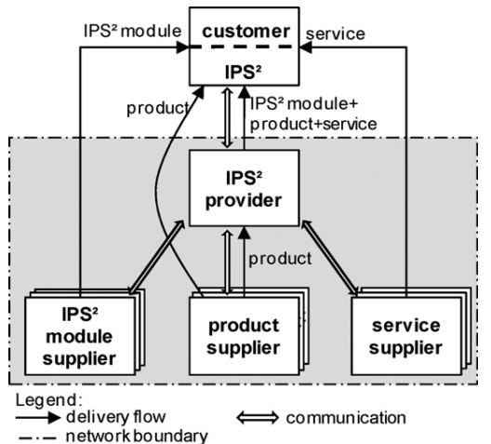
PSS Network
For the delivery of integrated products and services, more and more firms are entering into alliances and coalitions to build up a PSS network.
*Adopt from Meier, H., Roy, R., & Seliger, G. (2010)
And Meier, H., Dorka, T., & Morlock, F. (2013)

Slide 7
Research Gap
Maintenance Competence
Maintenance Performance
PSS Network service ability

Slide 8
Maintenance Performance
How intangible capital among PSS network partners can be effectively utilized for maintenance performance?
Intangible Capital
Knowledge
Human
Capital
Explicit
Knowledge
Maintenance
Performance
Organizational
Capital
Tacit
Knowledge
Fig. 1. Theoretical framework

Slide 9
Hypothesis Development
The influence of knowledge on maintenance performance
The mediating role of knowledge
The influence of intangible capital on knowledge

Slide 10
Hypothesis Development
The influence of intangible capital on knowledge
H1a: Human capital positively influences explicit knowledge.
H1b: Organizational capital positively influences tacit knowledge.
H1c: Human capital positively influences tacit knowledge based on the interaction with organizational capital.
H1d: Organizational capital positively influences explicit knowledge based on the interaction with human capital.

Slide 11
Hypothesis Development Cont.
The influence of knowledge on maintenance performance
H2a: Explicit knowledge positively influences maintenance performance for PSS.
H2b: Tacit knowledge positively influences maintenance performance for PSS.

Slide 12
Hypothesis Development Cont.
The mediating role of knowledge
H3a: Explicit knowledge mediates the relationship between human capital and maintenance performance.
H3b: Tacit knowledge mediates the relationship between organizational capital and maintenance performance.

Slide 13
Methodology
Data Collection
Construct Measures
An Empirical Investigation

Slide 14
An Empirical Investigation
Foton Lovol International Heavy Industry Co., Ltd.
S
D
S
D
S
ITI
S
ITI
S
D
ITI
S
D
S
S
D
S
ITI
Providers for intelligent terminal instruments
D
Distributors
S
Service Stations

Slide 15
Data Collection
Maintenance records > 1000
A subset of 200 firms
168 survey responses

Slide 16
Construct Measures
Table 1. Measurement items and results of confirmatory factor analysis of measures.

Slide 17
Construct Measures
Table 1. Measurement items and results of confirmatory factor analysis of measures. Cont.

Slide 18
Results and Discussions
Results of hypothesis testing
Validity and reliability of the constructs

Slide 19
Validity and Reliability
The reliability of the constructs was verified through the Cronbach’s Alpha, ranging from 0.777 to 0.836.
The Cronbach’s Alpha≥0.6 is valid in our study.

Slide 20
Validity and Reliability
Convergent validity can be estimated by looking at the item loadings. The factor loadings are shown in Table 1 for each construct.
All of the standardized item loadings were well above the cutoff of 0.50, supporting convergent validity.

Slide 21
Validity and Reliability
The fit indices are criteria for assessing the appropriateness of a structural equation model.
χ²/DF | CFI | GFI | IFI | TLI | RMSEA
242.484/127=1.909 | 0.933 | 0.852 | 0.934 | 0.919 | 0.075

Slide 22
Results of hypotheses testing
Table 2. Results of hypothesis testing.
The structural model supports all six hypotheses.

Slide 23
Results of hypotheses testing
H3a proposed the mediating role of explicit knowledge in the relationship between human capital and maintenance performance for PSS.
H3b demonstrated for the mediating role of tacit knowledge in the relationship between organizational capital and maintenance performance for PSS.

Slide 24
Results of hypotheses testing
We tested both two hypotheses by the addition of two direct paths from human capital and organizational capital to maintenance performance for PSS.
The path coefficients linking human capital and organizational capital to maintenance performance for PSS were non-significant, when the mediators were present with the same data fitting this model.

Slide 25
Conclusion
Knowledge as a mediator through which human and organizational capital benefit maintenance performance.
Human capital and organizational capital are positively related to knowledge type development, which in turn has a positive effect on maintenance performance in PSS networks.

Slide 26
Conclusion
The main contribution lies in the transformation of intangible capital into knowledge types and eventually maintenance performance, which lead to the development of a conceptual model that would explain the interrelationships among intangible capital and maintenance performance for PSS.

Slide 27
Future Research
Explore the interaction of the two types of knowledge
Demonstrate the technology capability moderating the effect of both explicit and tacit knowledge on maintenance performance in PSS networks.

Slide 28
Thank you for your attention

